Slide 1
Microsoft 365 Enterprise
License Map – May 2020
@AaronDinnage

Slide 2
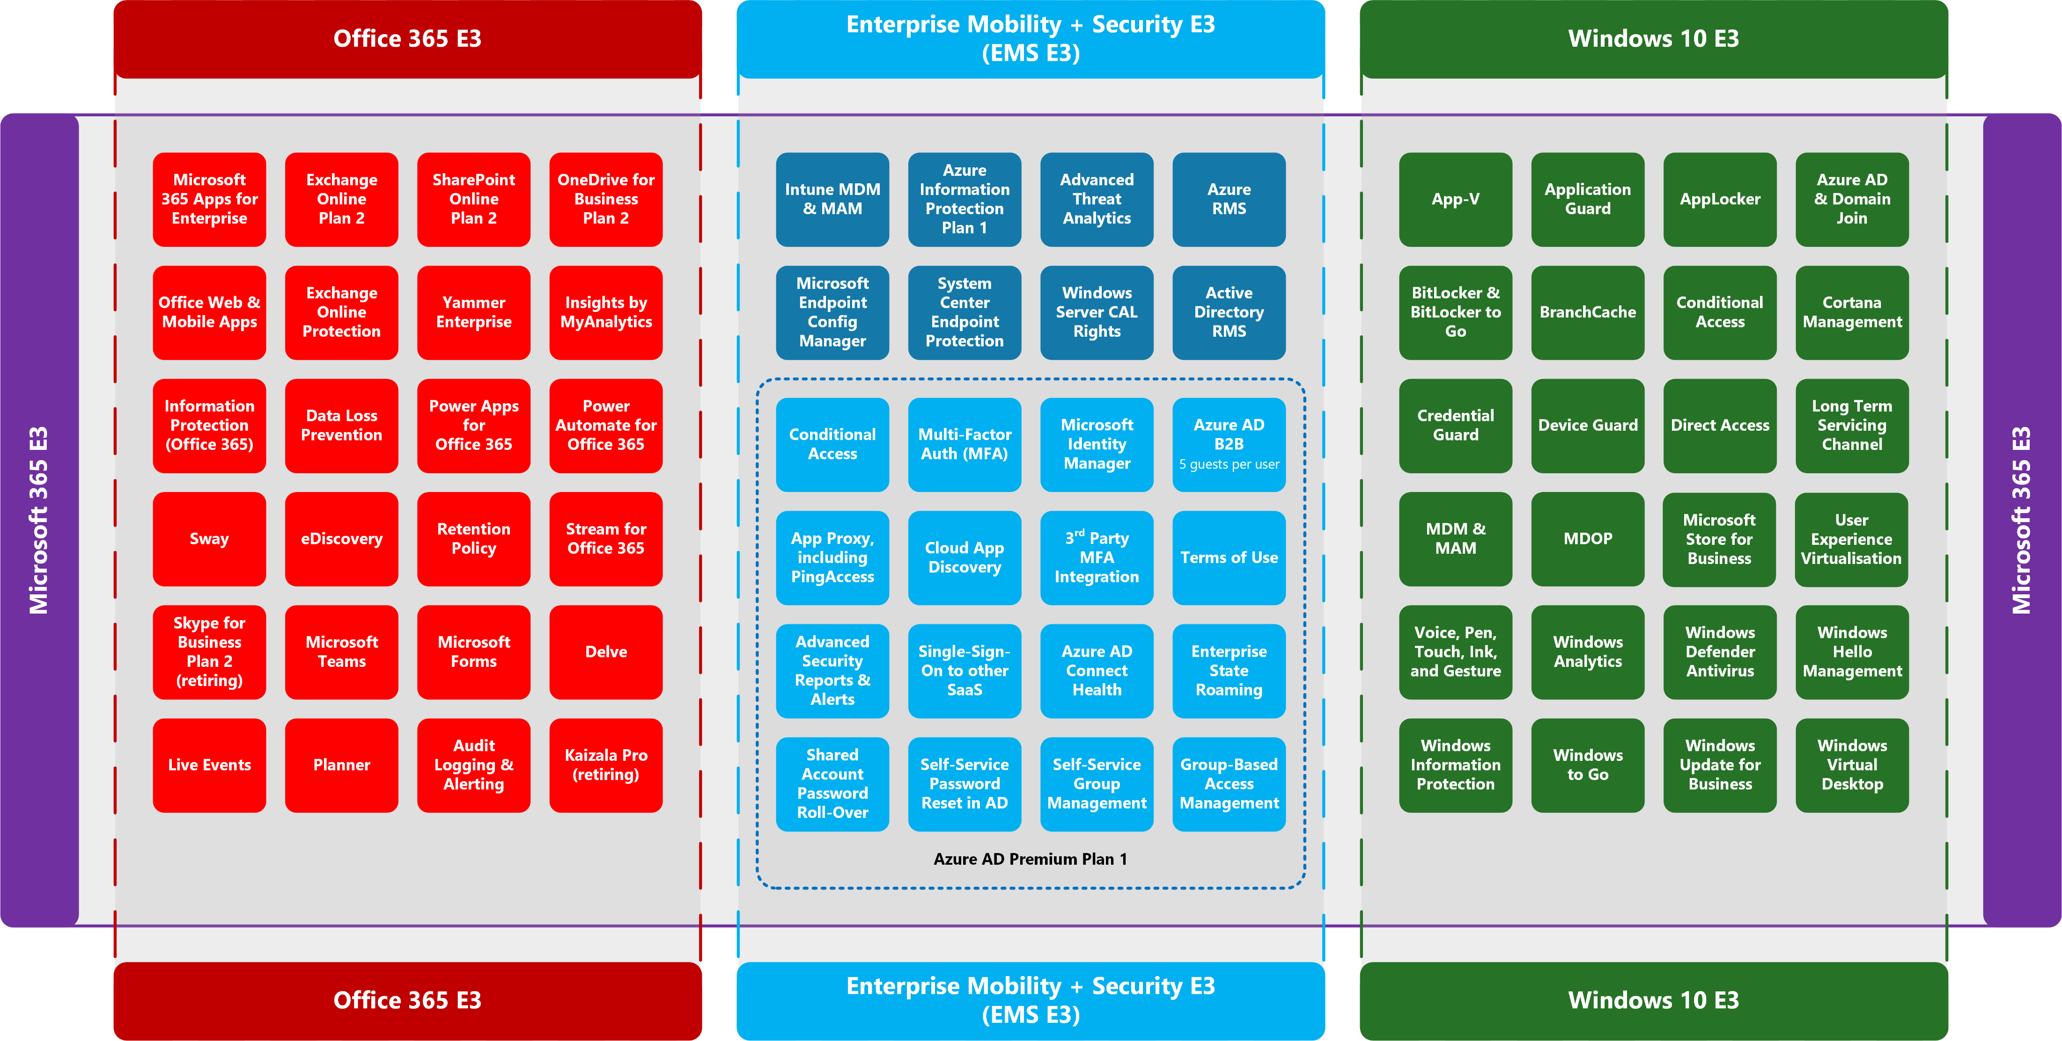
Latest diagrams available here: https://github.com/AaronDinnage/Licensing

Slide 3
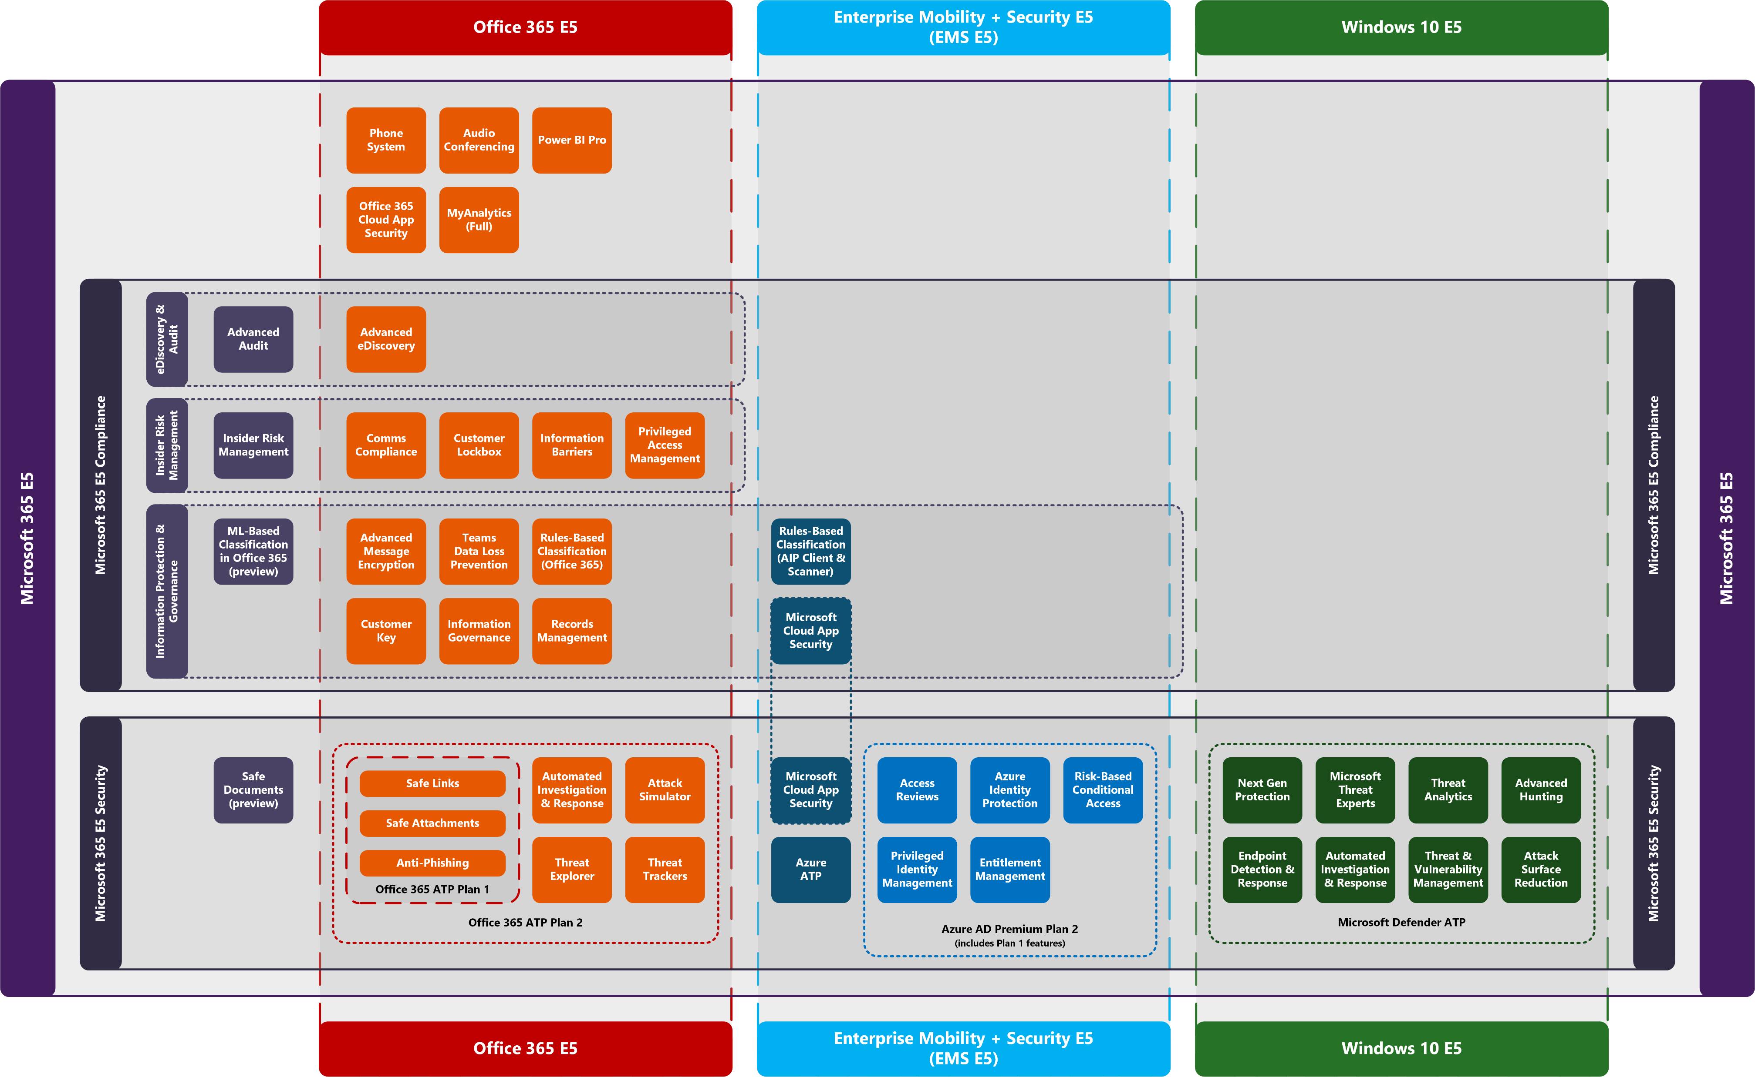
Latest diagrams available here: https://github.com/AaronDinnage/Licensing

Slide 4
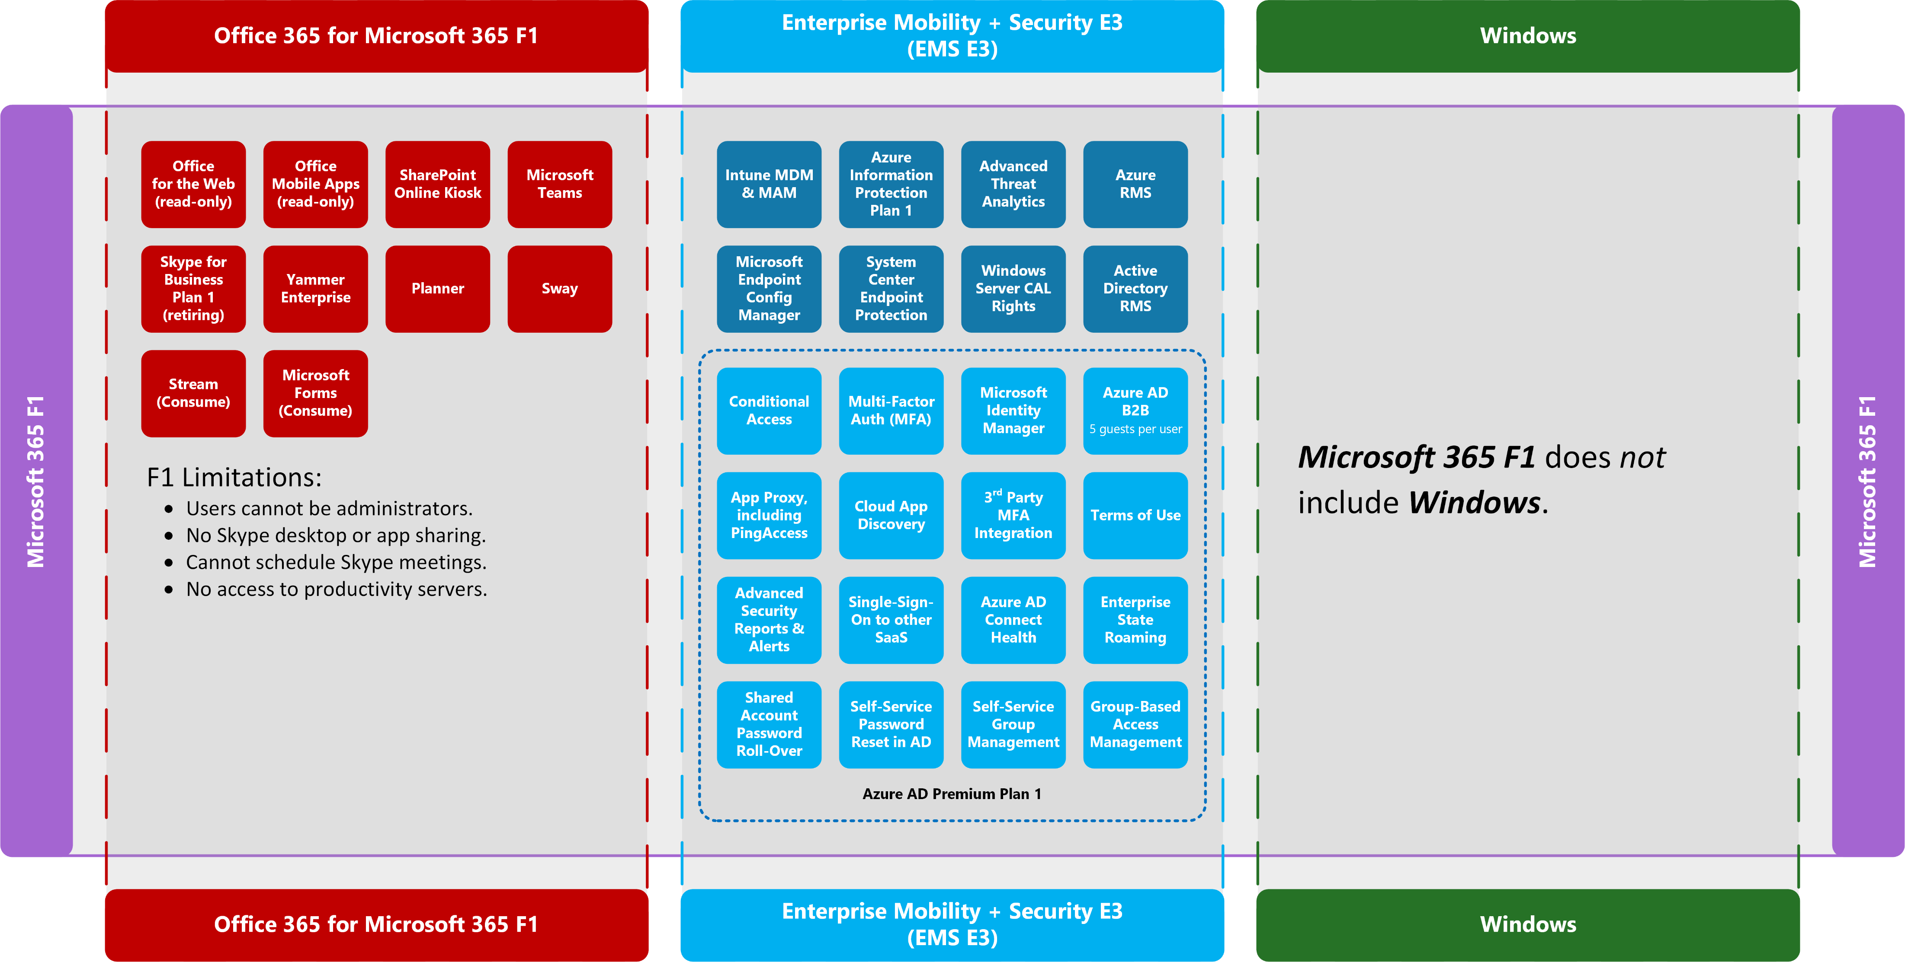
Latest diagrams available here: https://github.com/AaronDinnage/Licensing

Slide 5
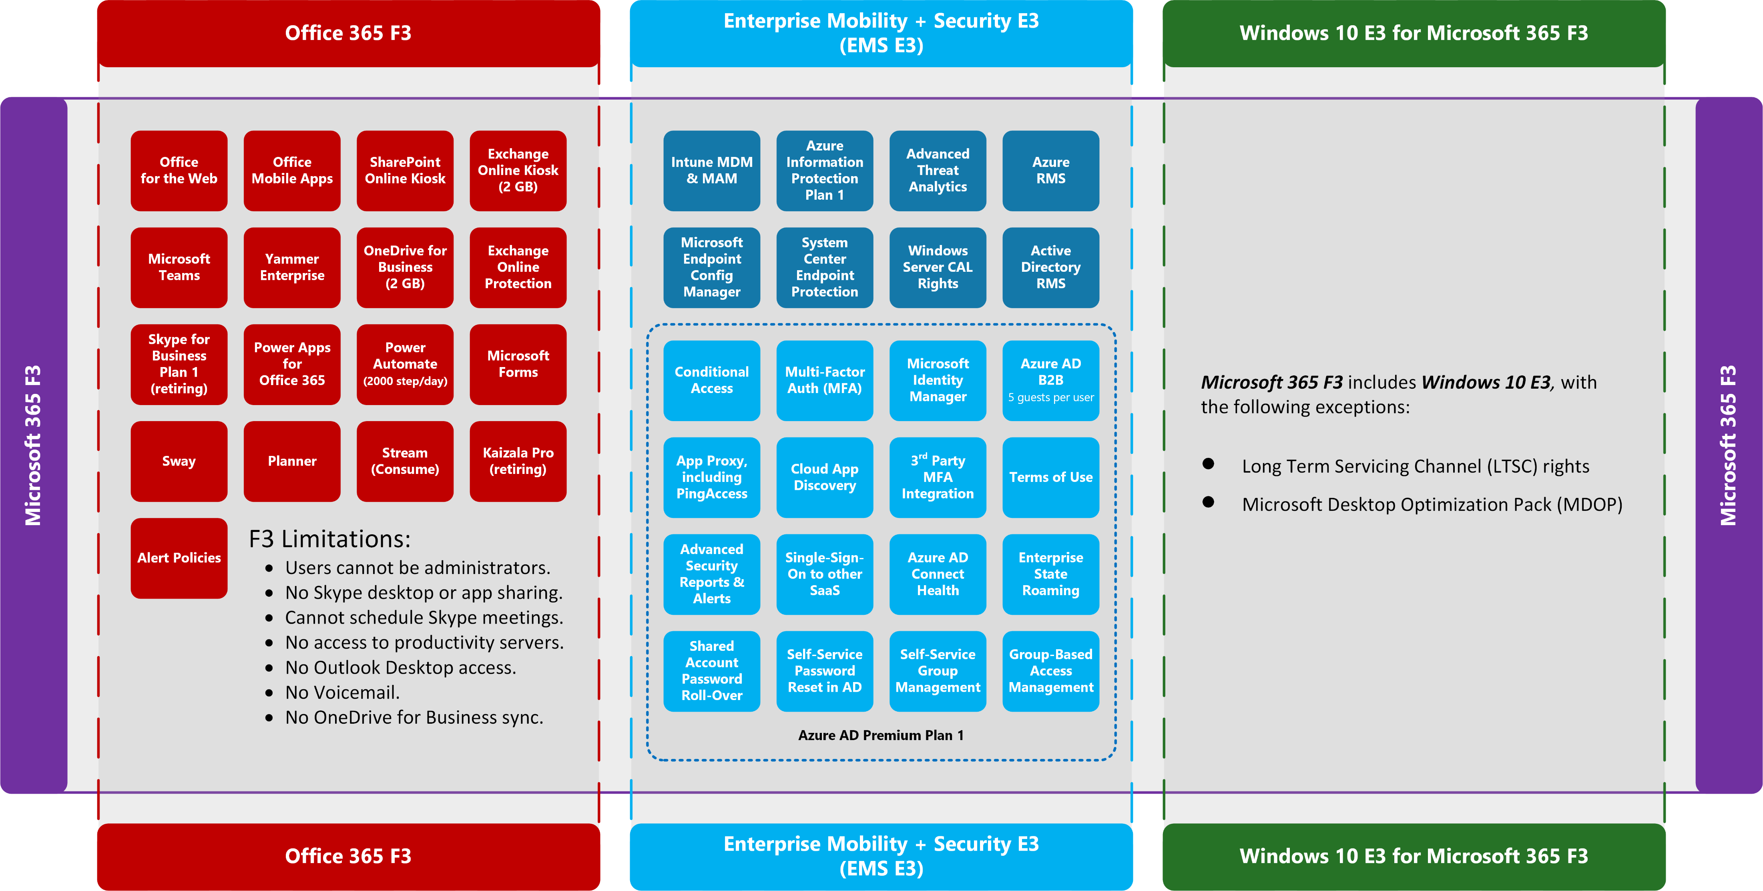
Latest diagrams available here: https://github.com/AaronDinnage/Licensing

Slide 6
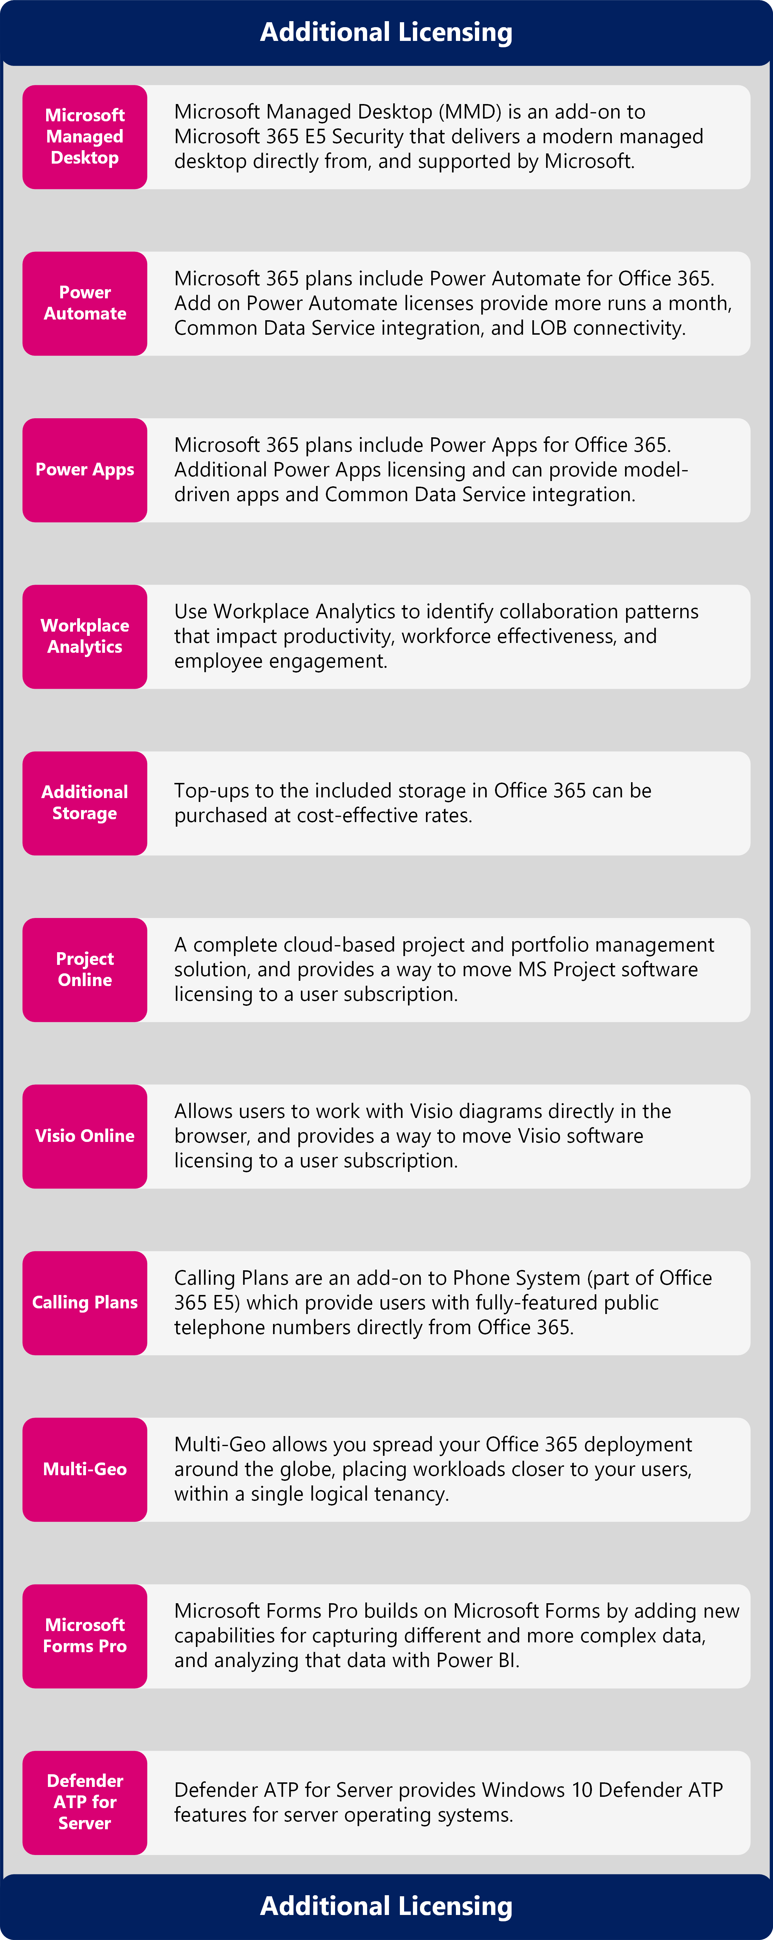
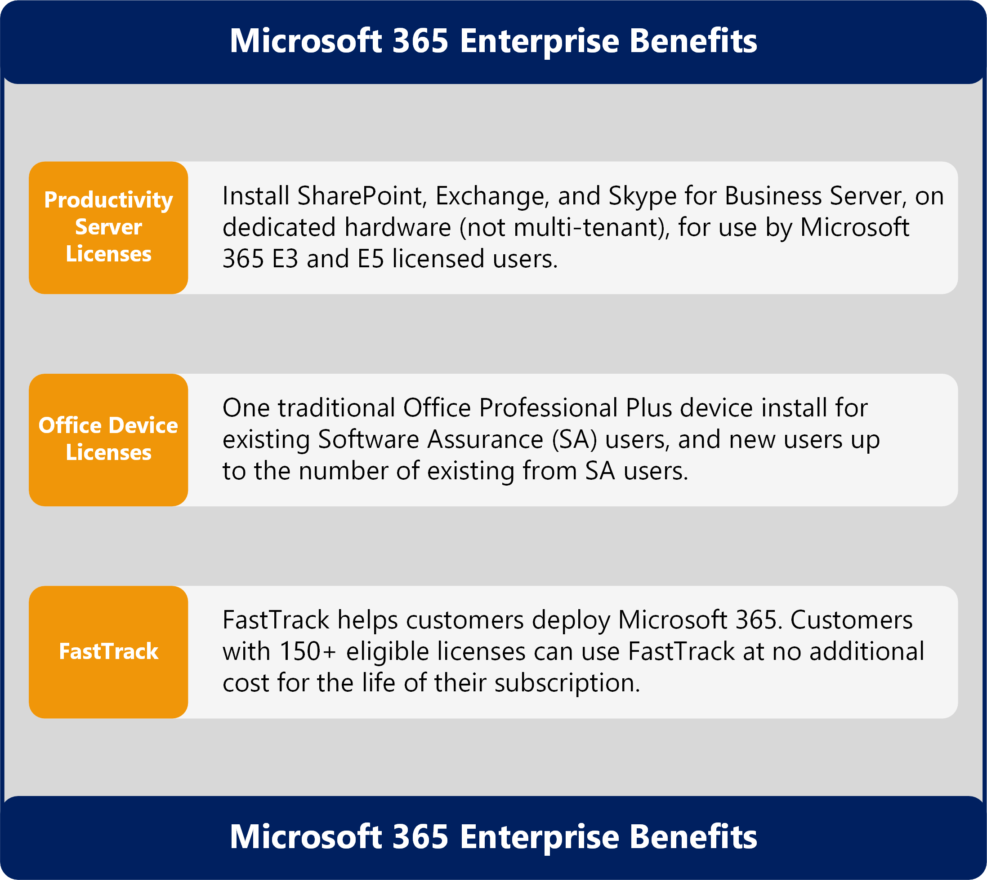
Microsoft 365 Benefits and Additional Licensing
Latest diagrams available here: https://github.com/AaronDinnage/Licensing

